Slide 1



Java Bootcamp 2018
Class 2:

Slide 2
Java Bootcamp 2018 - Class 2: Git
What is Git?
Distributed Version Control System
De facto standard (others: SVN, Mercurial)
Developed in 2005 by Linus Torvalds

Slide 3
Java Bootcamp 2018 - Class 2: Git
How does it work?
Repository
Collection of files and folders associated with a project
Each of these along with their revision history → git log
Snapshots in time → commits
Commits can be organized into multiple lines of development → branches
.gitignore

Slide 4
Java Bootcamp 2018 - Class 2: Git
Basic commands
git init
git clone
git add
git commit
git status
git merge → conflicts
git pull
git push

Slide 5
Java Bootcamp 2018 - Class 2: Git
Local
Remote
Working directory
Staging area
Local repository
Remote repository
git add
git commit
git push
git pull
git checkout
git merge

Slide 6

Java Bootcamp 2018 - Class 2: Git

Slide 7

Java Bootcamp 2018 - Class 2: Git
Centralized repo
Repo to repo collaboration
SVN
repo
Git
repo
Git
repo
Git
repo
Working copy
Working copy
Working copy

Slide 8
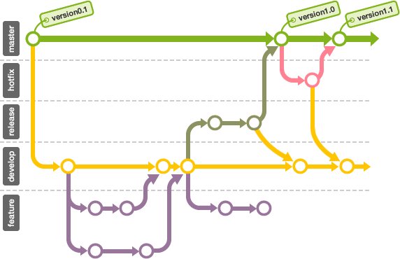
Java Bootcamp 2018 - Class 2: Git

Slide 9
Java Bootcamp 2018 - Class 2: Git
Forking a repository
clone in github
Local
Remote
Local repository
Origin
Upstream
git push origin
git pull origin
git fetch upstream

Slide 10
Java Bootcamp 2018 - Class 2: Git
Pull Request
Propose and collaborate on changes to a repository branch
Code review
Approve
Request changes
Merge

Slide 11
Java Bootcamp 2018 - Class 2: Git
Benefits
Open Source
Security
Files content and relations between them secured with SHA1 hashing algorithm
Flexibility
Support for nonlinear development workflows
Efficient in any project regardless of its size

Slide 12

Java Bootcamp 2018 - Class 2: Git
Benefits
Full access
To every file, branch and iteration of a project
Full and self-contained history of changes

Slide 13
Java Bootcamp 2018 - Class 2: Git
Benefits
Simple and powerful
Be careful!

Slide 14
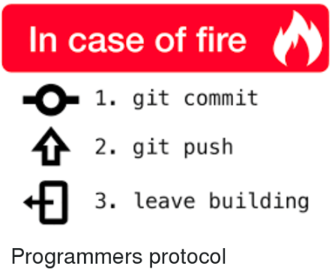
Java Bootcamp 2018 - Class 2: Git

Slide 15

Java Bootcamp 2018 - Class 2: Git
Challenge
Create a PR against master branch to include your group name and members in the README.md file. The PR must not have any conflicts.

Slide 16
Java Bootcamp 2018 - Class 2: Git
Bibliography
http://rogerdudler.github.io/git-guide/
https://marklodato.github.io/visual-git-guide/index-en.html
https://guides.github.com/introduction/git-handbook/
https://www.atlassian.com/git/tutorials/learn-git-with-bitbucket-cloud

Slide 17
Java Bootcamp 2018 - Class 2: Git
Any questions?

